Slide 1
Notes:
CONFIDENTIALITY NOTICE – This presentation and any documents, files or previous messages attached to it may contain proprietary, confidential and/or privileged material. If you are not the intended recipient, you are strictly prohibited from reading, reviewing, retransmitting, disclosing, copying, printing, distributing, disseminating or otherwise using any of the information contained in or attached to this documentation. All information provided in this presentation may not be redistributed, copied or used in any form without the express consent of Chatsworth products.

Slide 2

Agenda
The traditional (480V) US data center power systems
The 415V AC power system
Understanding how greater efficiency helps lower Total Cost of Ownership (TCO)
Illustrating TCO savings with the 415V AC power distribution systems
Focus on 415V Cabinet PDUs
Conclusion

Slide 3
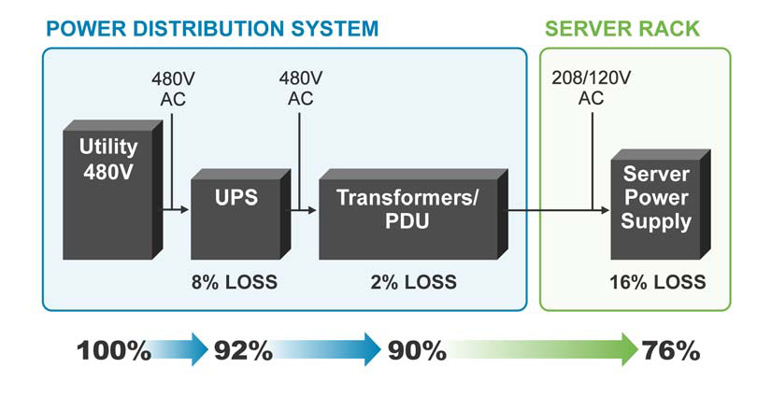
The Traditional US Data Center Power System
The chain of electrical elements used to deliver 208V/120V AC power to load
The Uninterruptible Power Supply (UPS) provides a reliable and clean power while giving seamless backup power protection
The isolation transformer and power distribution unit (PDU) are typically combined and often times several are needed
Note: Most IT equipment can take 120V, 208V, or 240V (power supplies are rated 100V-250V)

Slide 4
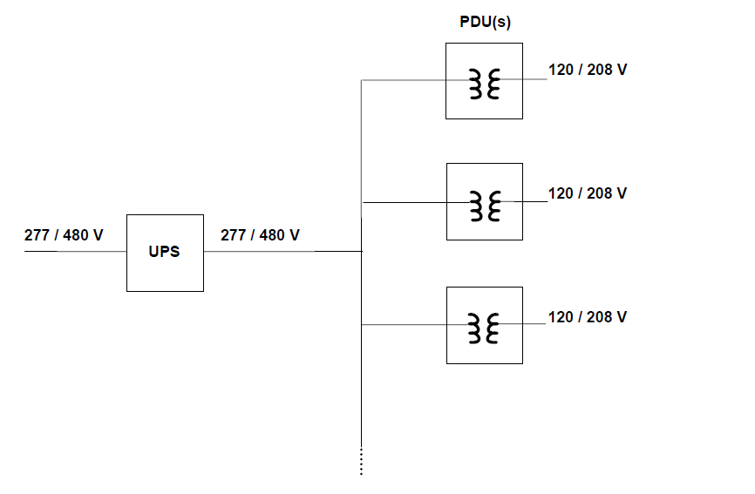
One-line Diagram: Standard Power Distribution System in North America

Slide 5
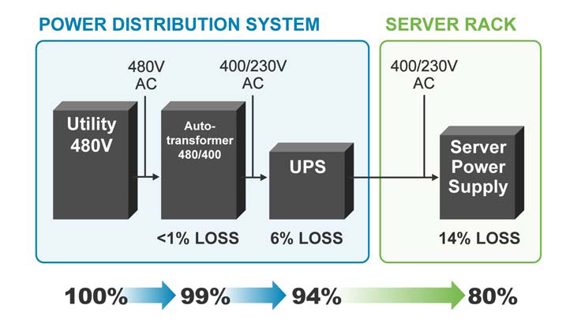
The 415V AC Power System
The 415V power distribution model is typically used across Europe, Asia and South America
415V systems offer several efficiency advantages compared to the 480V AC models
The 415V, the neutral is distributed throughout the system, eliminating the need for the isolation transformer
Delivers 240V Line-to-Neutral power directly to the load
Enables the system to perform more efficiently and reliably
Lowers capital expenditures (CAPEX)P by omitting multiple isolation transformers required in the 480V systems
415/240V
415/240V

Slide 6
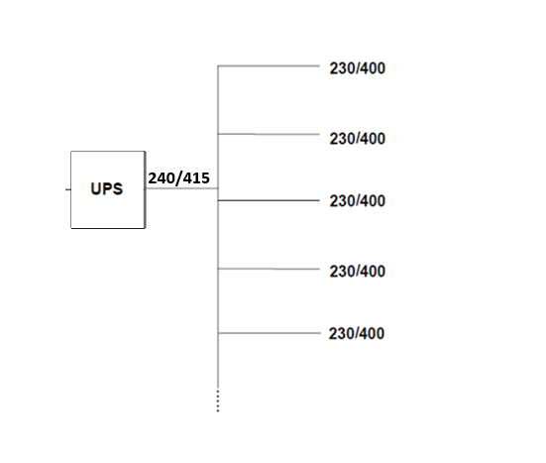
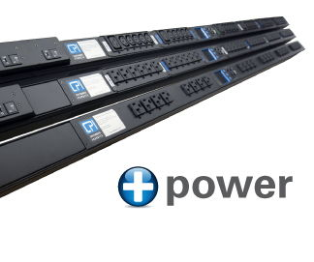
alternative power distribution system for North American data centers
UPS power directly to the cabinet PDU
240/415
240/415
240/415
240/415
240/415

Slide 7
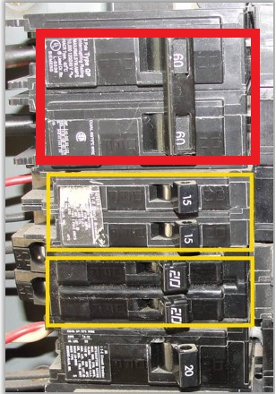
Breaker Panel Saving
Standard breaker panel has 42 positions
L6-30 single phase delivery takes a two-pole breaker = 21 circuits per panel
  4.9kW per circuit = 102.9kW per panel
240V 32Amp single phase delivery takes a single pole breaker = 42 circuits per panel
  7.3kW per circuit = 306.6kW per panel

Slide 8



Understanding How Greater Efficiency Helps Lower TCO
TCO for the power distribution system is determined by adding CAPEX, such as equipment purchase, installation and commissioning costs, and operational expenditures (OPEX), which include the cost of electricity to run both the UPS and the cooling equipment required to remove heat resulting from the normal operation of the UPS
Breaker panel density
Run higher density KW over the same copper wires
415V system’s higher efficiency significantly lowers OPEX costs in the first year of service throughout the typical 15-year life span of power equipment

Slide 9
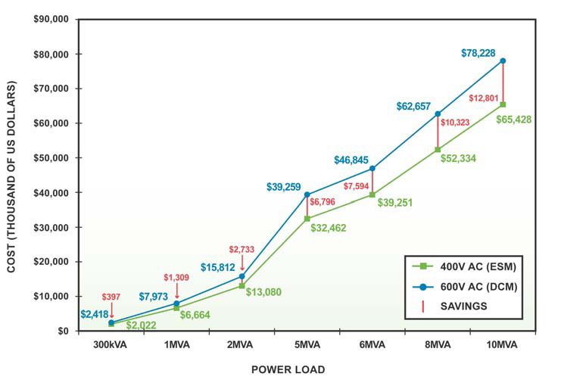
Illustrating TCO Savings with the /240V400V AC Power Distribution System
415V
208V
15-year TCO (240V/415V AC Energy Saver Mode vs. 120V/208V AC double conversion mode)

Slide 10
415V 3-Phase Rack Power Distribution
415V 3-Phase Rack Power Distribution
415V Rack Power Strips limit energy loss through transformers by avoiding the 480-208 volt conversion.
These units use European standard, three-phase 415 volt Line-to-Line – 240 volt Line-to-Neutral - replacing 208 volt phase-to-phase in the US. Operating power supplies at 240 volt versus 208 volt typically increases power supply efficiency.
415V PDUs also distribute almost twice the power on the same copper to achieve multiple reductions.
Containerized data centers
Customers looking for global standard
Progressive data centers looking for cost reductions and efficiency gains

Slide 11
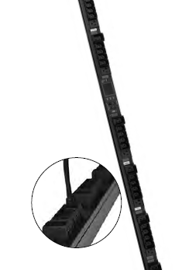
120V/208V versus 240V/415V Rackmount PDUs : KW Rating
30Amp 120V/208V provides 8.6kW
60Amp 120V/208V provides 17.2kW
30Amp 240V/415V provides 17.2kW
16Amp 240V/415V provides 11kW
32Amp 240V/415V provides 22kW
60Amp 240V/415V provides 34.4kW

Slide 12
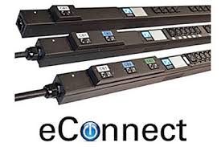
240V/415V Cabinet PDU Details : eConnect
Basic, Metered, Monitored, Monitored Pro, Switched, Switched Pro
Horizontal & Vertical
Customized units
Compatible with Electronic Locks
Environmental Monitoring
Locking Receptacles
Secure Array
High Outlet Density
65C / 149F UL Listed Temperature Rating

Slide 13
Conclusion
The 415V AC power distribution system offers the highest degree of electrical efficiency for modern data centers, significantly reducing capital and operational expenditures and total cost of ownership as compared to 480V AC power systems.
Recent developments in UPS technology—including the introduction of transformer-less UPSs and new energy management features (i.e. Energy Saver Mode)—further enhance the 415V AC power distribution system for maximum efficiency.
This conclusion is supported by IT industry experts (i.e. USBGC) who theorize that 415V AC power distribution will become standard as U.S. data centers transition away from 480V AC to a more efficient and cost-effective solution over the next several years.

